Slide 1
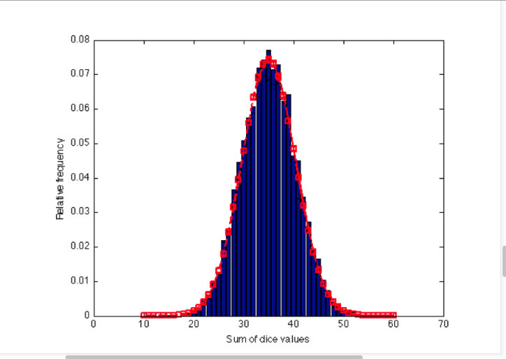
Probability density function pdf
A probability density function (PDF), or density of a continuous random variable, is a function whose value at any given sample (or point) in the sample space (the set of possible values taken by the random variable) can be interpreted as providing a relative likelihood that the value of the random variable would equal that sample.

Slide 2
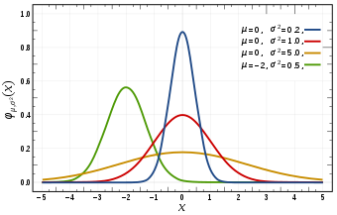
Normal distribution
The normal distribution is a continuous probability distribution. This has several implications for probability.
The total area under the normal curve is equal to 1.
The probability that a normal random variable X equals any particular value is 0.
About 68% of the area under the curve falls within 1 standard deviation of the mean.
About 95% of the area under the curve falls within 2 standard deviations of the mean.
About 99.7% of the area under the curve falls within 3 standard deviations of the mean.

Slide 3
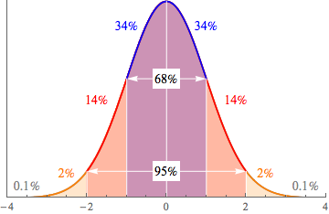
Standard normal distribution
The standard normal distribution is a special case of the normal distribution. It is the distribution that occurs when a normal random variable has a mean of zero and a standard deviation of one.
The normal random variable of a standard normal distribution is called a standard score or a z-score. Every normal random variable X can be transformed into a z score via the following equation:
z = (X - μ) / σ
where X is a normal random variable, μ is the mean of X, and σ is the standard deviation of X.

Slide 4
Z score
A Z score describes how far a raw score falls from the mean in standard deviation units.
Subtract the mean from the raw score and divide by the standard deviation
Z score looks like +1.32, +0.01, -1.96, +0.75
The sign tells us whether the observation is above or below the mean. Negative means below whereas positive means above.
Number tells us the score and mean in terms of standard
The mean is always Z = 0
A z-score (aka, a standard score) indicates how many standard deviations an element is from the mean. A z-score can be calculated from the following formula.
z = (X - μ) / σ

Slide 5
Common uses for z-score
A z-score distribution results after transforming a distribution of raw score into z score.
Distribution is the shape of normal curve i.e. it has a mean of zero and a standard deviation of 1
Z score not falling in between – 1.96 between + 1.96 are statistically significant.
Larger the z-score larger the value of raw score
In a normal distribution the z-score limits are approximately equal to +3 and -3. standard deviations

Slide 6
Z table
Z score can tell us what portion of our population is below or above then the value in question
For Z < +1.00 there are exactly .8413 percent of the population below this value.
How am I getting this value?
It’s an area under normal curve which is a bell shaped curve
Problem
Molly earned a score of 940 on a national achievement test. The mean test score was 850 with a standard deviation of 100. What proportion of students had a higher score than Molly? (Assume that test scores are normally distributed.). Use Z table from http://www.z-table.com/
Ans - ??

Slide 7
solution
First, we transform Molly's test score into a z-score, using the z-score transformation equation. z = (X - μ) / σ = (940 - 850) / 100 = 0.90
Then, using an online calculator (e.g., Stat Trek's free normal distribution calculator), a handheld graphing calculator, or the standard normal distribution table, we find the cumulative probability associated with the z-score. In this case, we find P(Z < 0.90) = 0.8159.
Therefore, the P(Z > 0.90) = 1 - P(Z < 0.90) = 1 - 0.8159 = 0.1841.
Thus, we estimate that 18.41 percent of the students tested had a higher score than Molly.

Slide 8
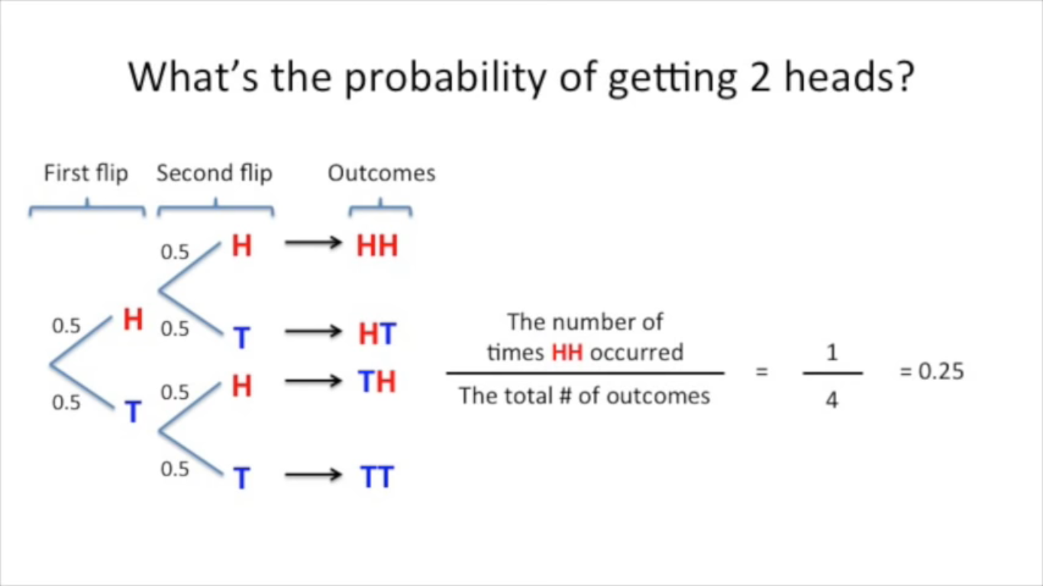
P-value
P-value is often confused with Probability Value but they are very different and have different meaning to it.
P-value is the probability that a random chance generated the data, or something else that is equal or rarer.
It consists of the parts as coloured above
Probability of getting two staright head is 0.25. But p-value?

Slide 9
continued
1st part as marked in read is already been calculated as ¼ = 0.25
2nd part is two add anything which has equal probability i.e. TT which again = ¼ = 0.25
3rd part is to add up anything which is even more rarer. Since there is no outcome which is rarer than HH this part will be equal to 0
Adding up the three parts P-value for HH is (0.25 + 0.25 + 0) = 0.5
So we saw the P(HH) = 0.25
P-value = 0.5

Slide 10
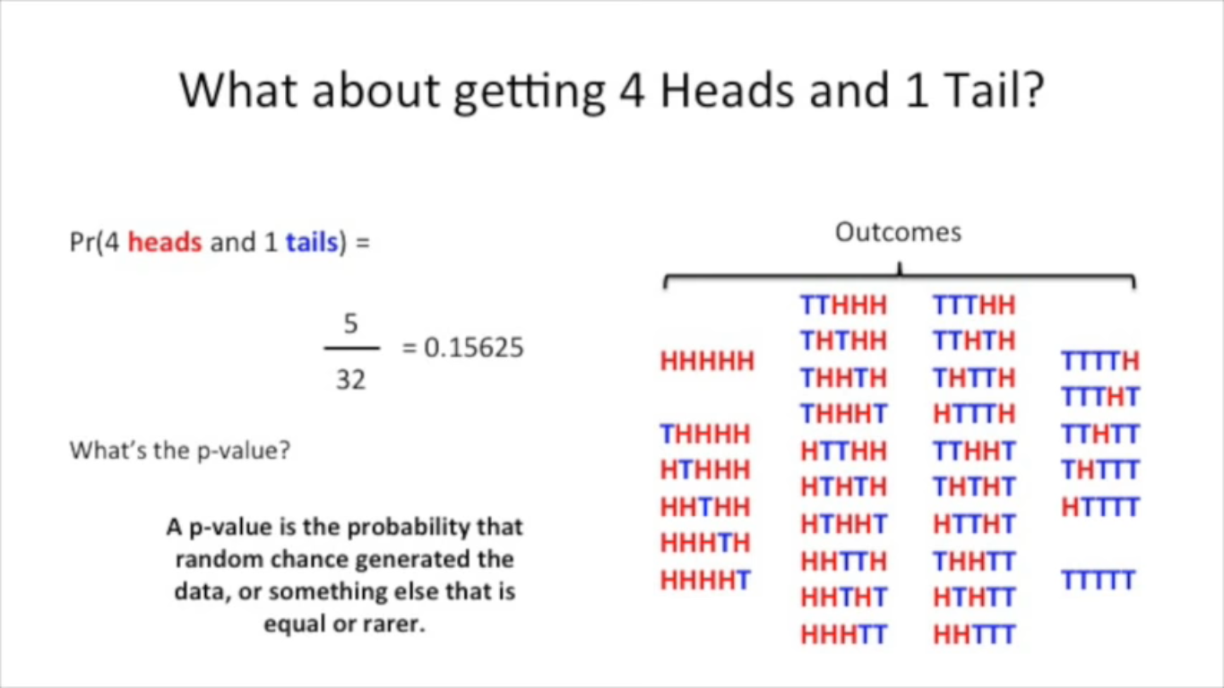

Complicated example

Slide 11
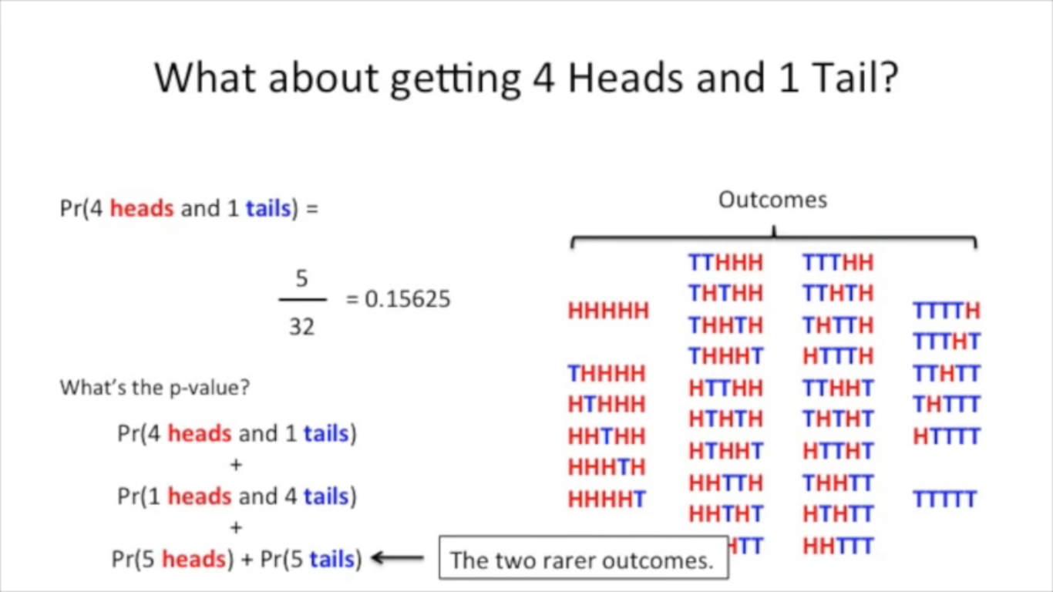

Slide 12
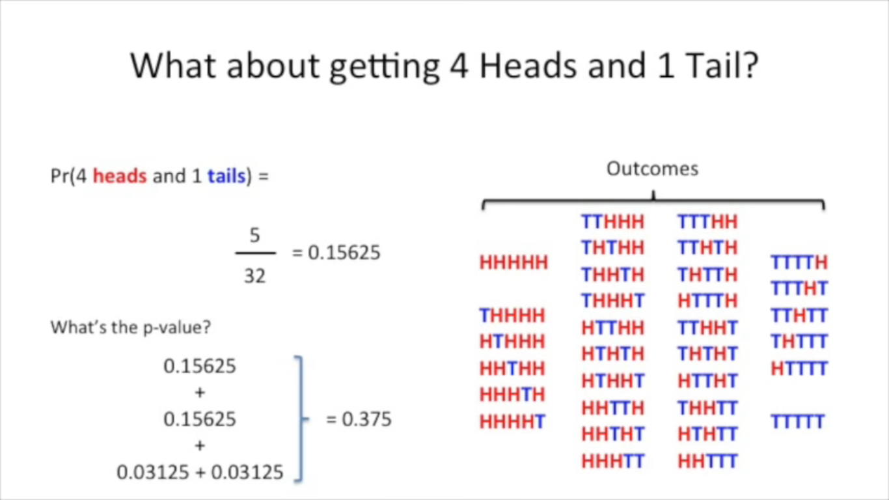

Slide 13
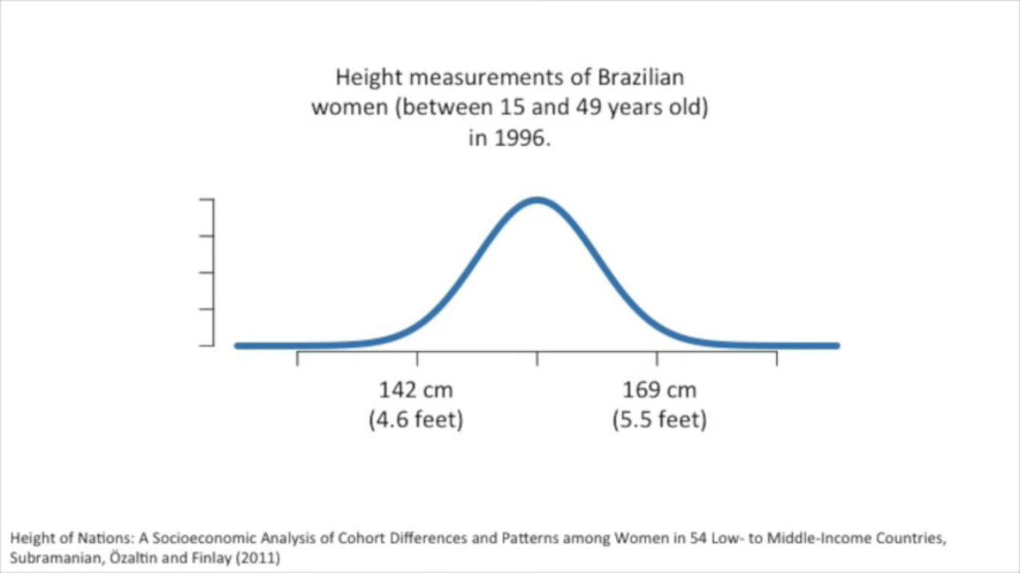
Continous variable
How do we calculate p-value for continuous variable? Like People’s income, Average Weight?
We use the probability density function
Area under the curve always gives us the probability value and the value at that particular instance gives us the likelihood of the value.
Calculating p-value we should only be bothered about area
To calculate the p-value you add up area under the percentages curve

Slide 14
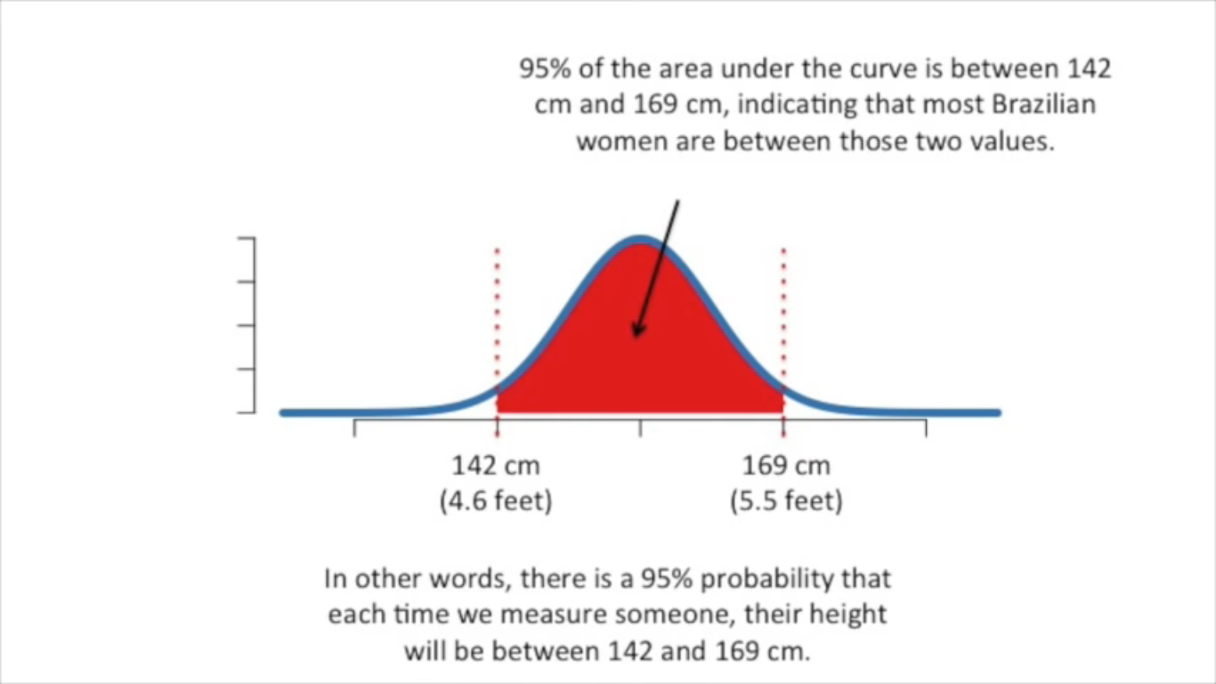

Slide 15
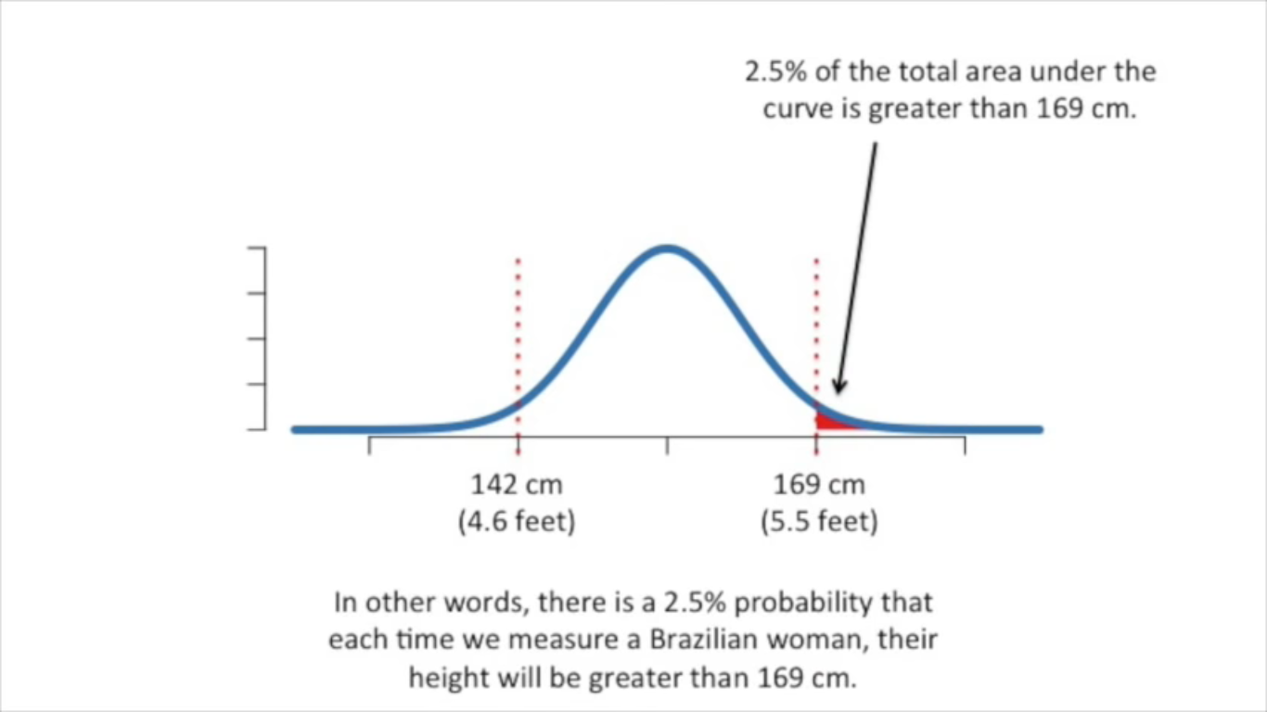

Slide 16
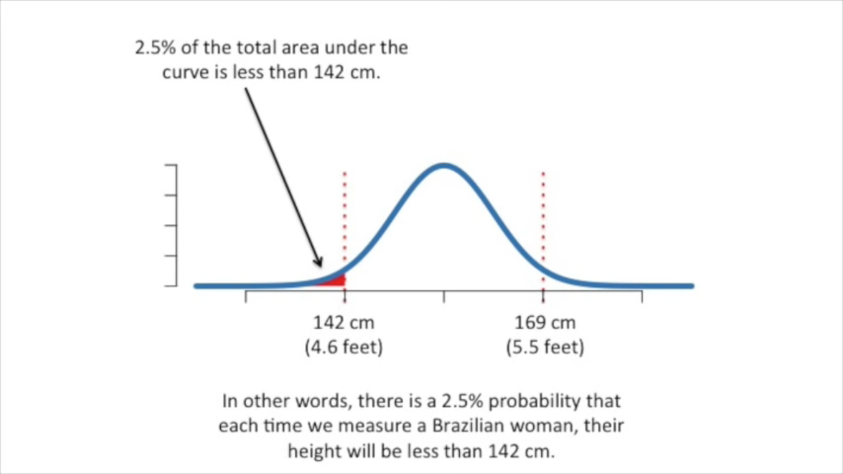

Slide 17
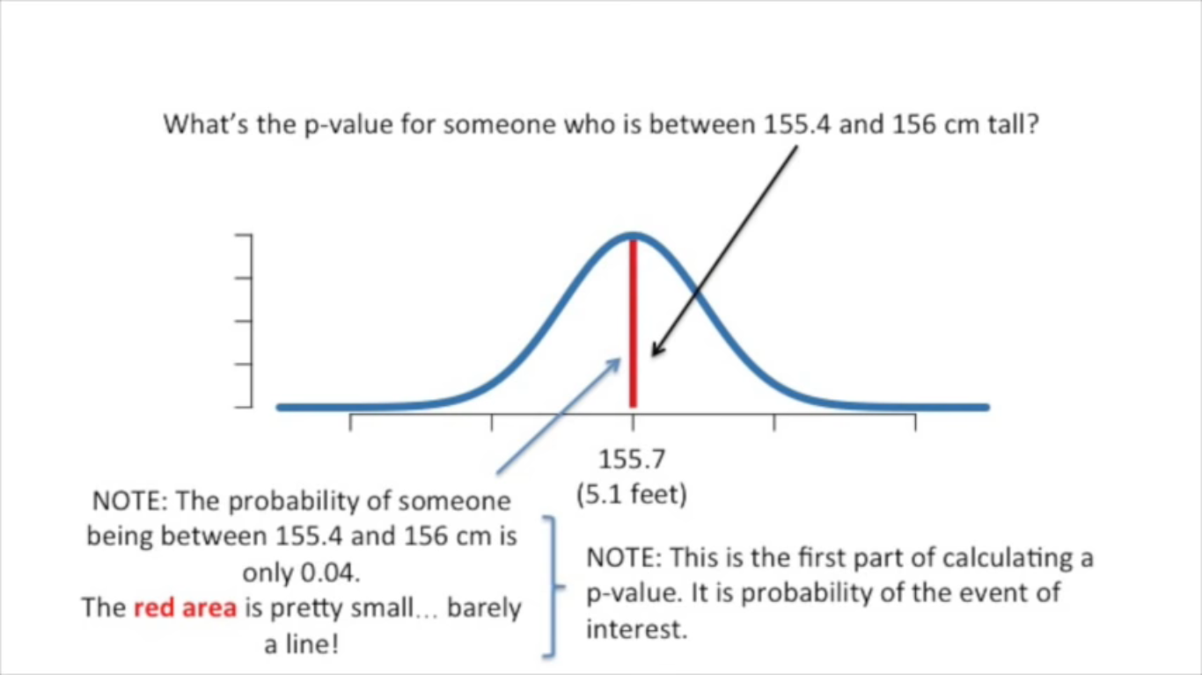

Slide 18
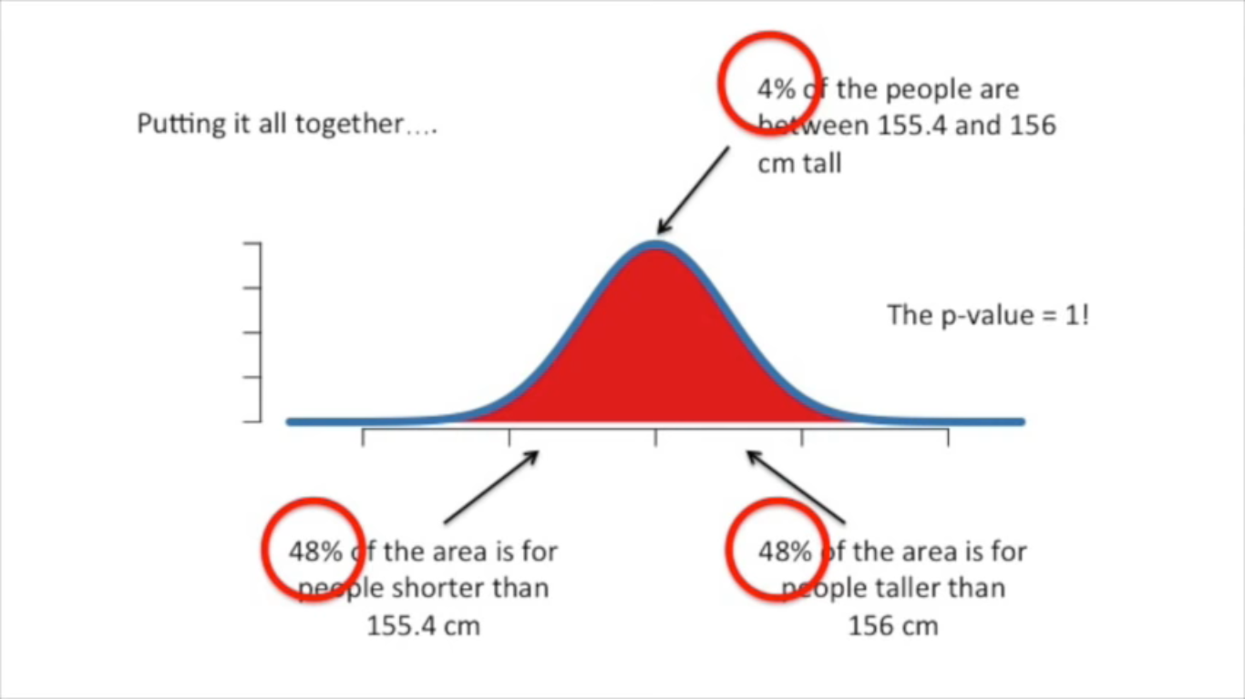

Slide 19
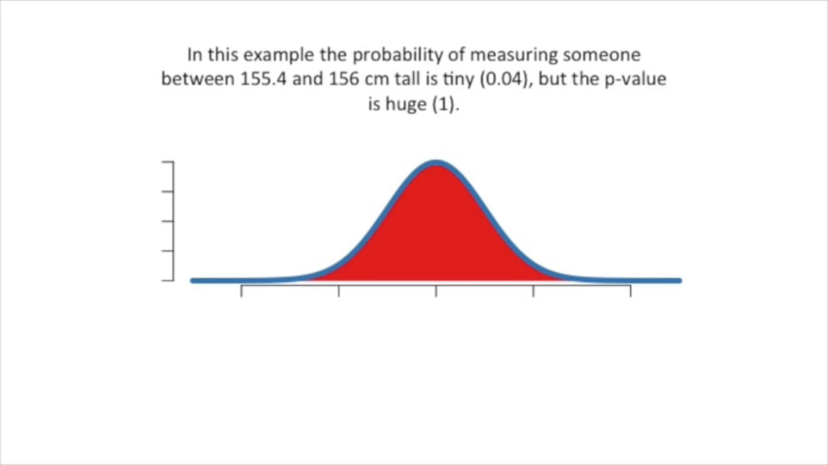
This means there is nothing special about guessing some one’s height between 155.4cm to 156cm although that event in itself is rare.

Slide 20
Hypothesis testing
Data must be interpreted in order to add meaning.
We can interpret data by assuming a specific structure our outcome and use statistical methods to confirm or reject the assumption. The assumption is called a hypothesis and the statistical tests used for this purpose are called statistical hypothesis tests.
Whenever we want to make claims about the distribution of data or whether one set of results are different from another set of results in applied machine learning, we must rely on statistical hypothesis tests.
Statistical hypothesis tests are important for quantifying answers to questions about samples of data.
The interpretation of a statistical hypothesis test requires a correct understanding of p-values and critical values.
Regardless of the significance level, the finding of hypothesis tests may still contain errors.

Slide 21
Hypothesis testing
In statistics, a hypothesis test calculates some quantity under a given assumption. The result of the test allows us to interpret whether the assumption holds or whether the assumption has been violated.
Two concrete examples that we will use a lot in machine learning are:
A test that assumes that data has a normal distribution.
A test that assumes that two samples were drawn from the same underlying population distribution.
The assumption of a statistical test is called the null hypothesis, or hypothesis 0 (H0 for short). It is often called the default assumption, or the assumption that nothing has changed.
A violation of the test’s assumption is often called the first hypothesis, hypothesis 1 or H1 for short. H1 is really a short hand for “some other hypothesis,” as all we know is that the evidence suggests that the H0 can be rejected.

Slide 22
Null and alternate hypothesis
Hypothesis 0 (H0): Assumption of the test holds and is failed to be rejected at some level of significance.
Hypothesis 1 (H1): Assumption of the test does not hold and is rejected at some level of significance.
The results of a statistical hypothesis test must be interpreted for us to start making claims
There are two common forms that a result from a statistical hypothesis test may take, and they must be interpreted in different ways. They are the p-value and critical values.
If p-value > alpha: Fail to reject the null hypothesis (i.e. not significant result).
If p-value <= alpha: Reject the null hypothesis (i.e. significant result).
For example, if we were performing a test of whether a data sample was normal and we calculated a p-value of .07, we could state something like:

Slide 23
Steps for hypothesis testing
State Null (H0) and Alternative Hypothesis (H 1)
Choose significance level alpha
Find Critical Values
Find test Statistic
Draw your conclusion

Slide 24
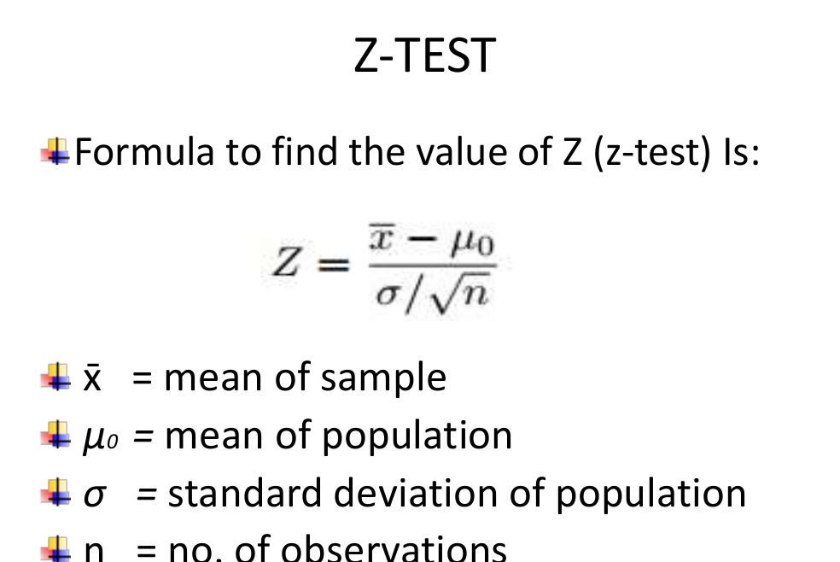
Z-test

Slide 25
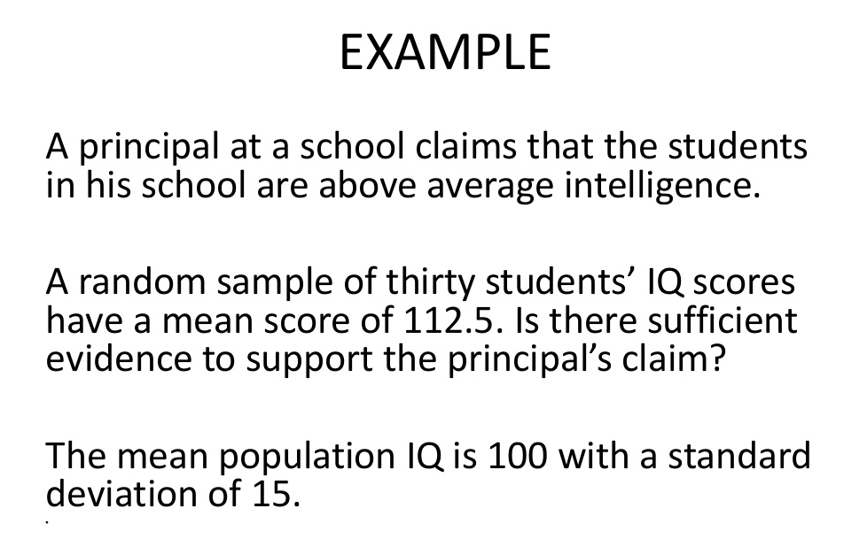

Slide 26
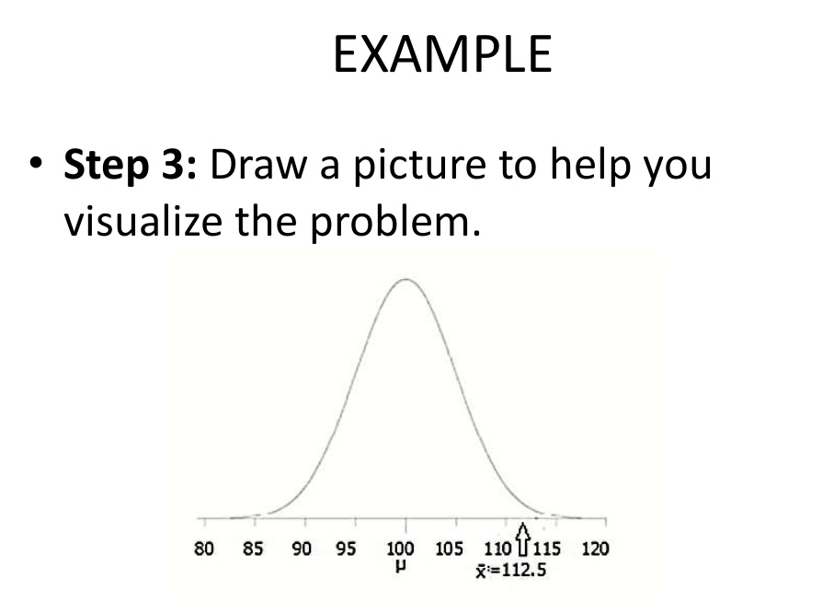
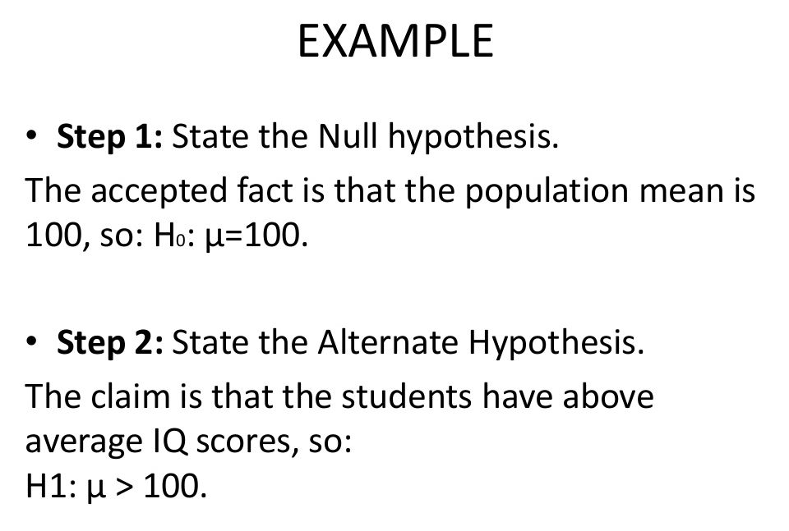

Slide 27
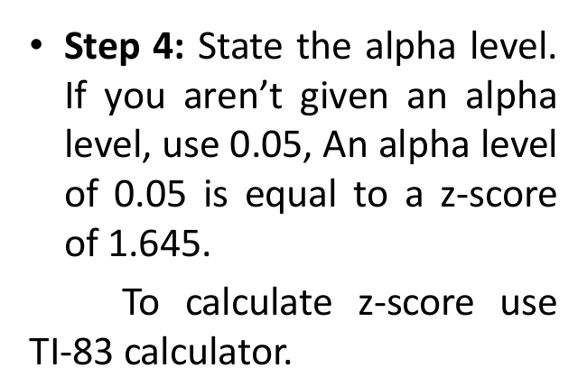
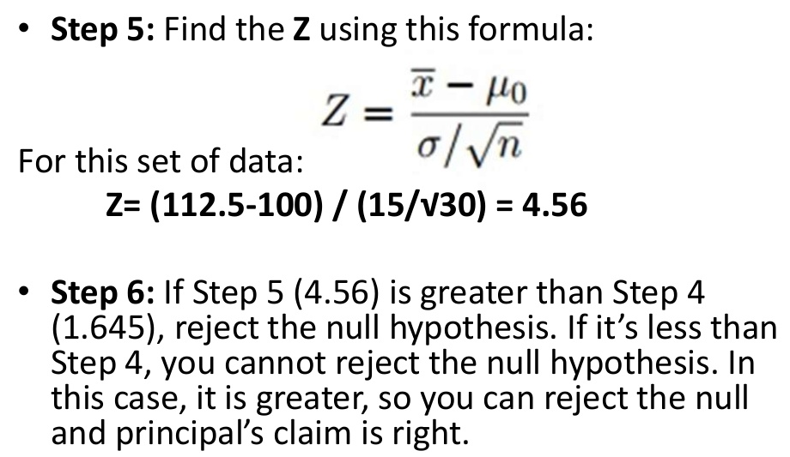

Slide 28
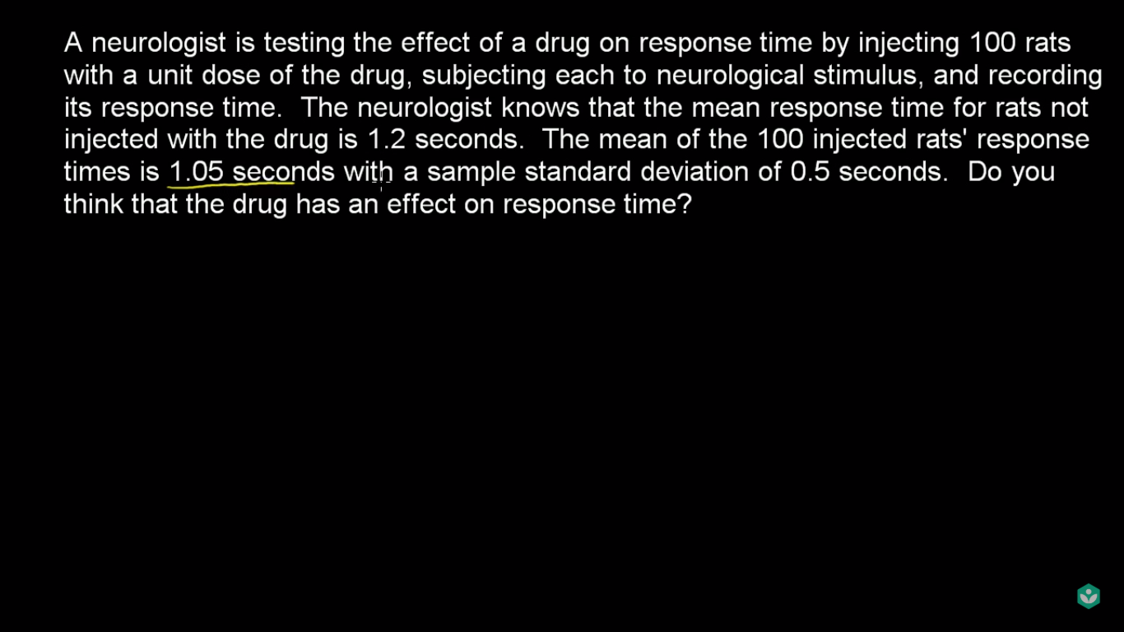

Slide 29
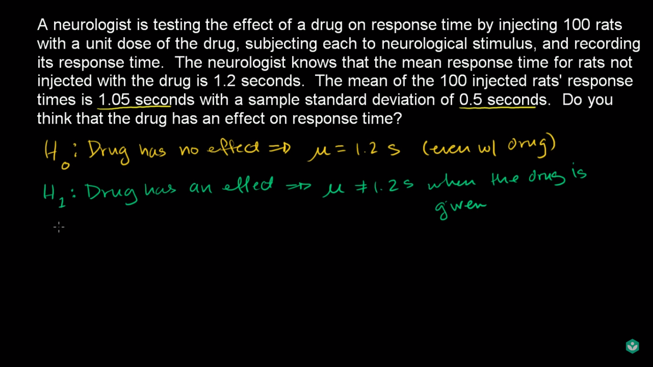

Slide 30
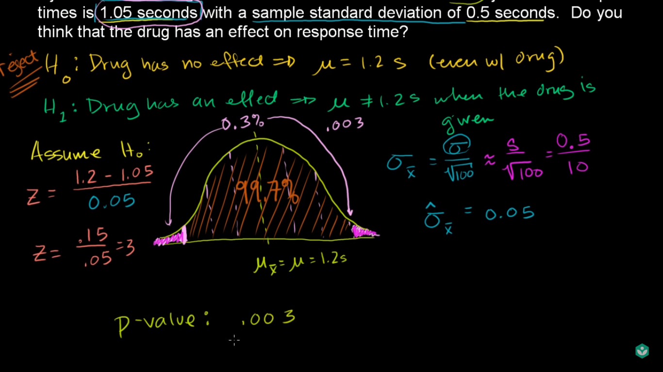

Slide 31
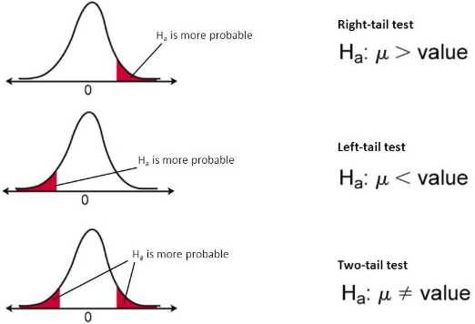

Slide 32


Slide 33
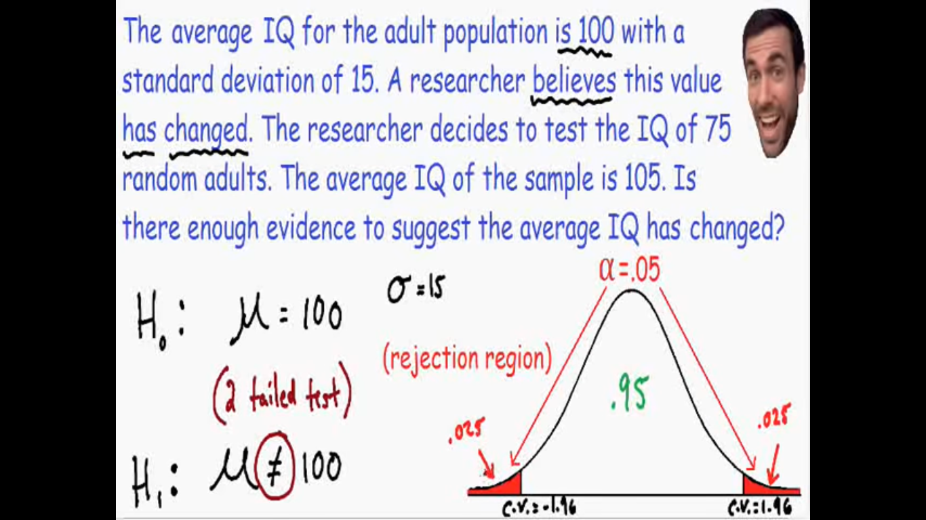
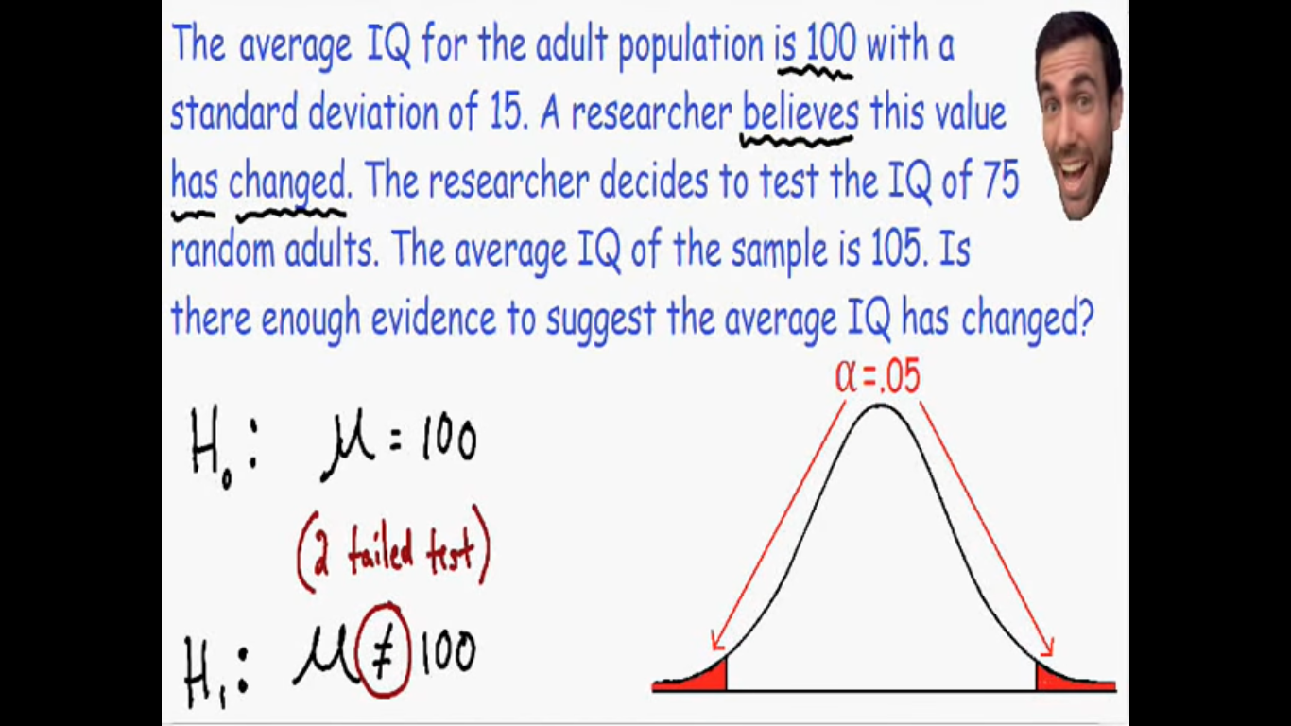
Why is statistics important
The study of statistics revolves around the study of data sets. This lesson describes two important types of data sets -populations and samples.
The main difference between a population and sample has to do with how observations are assigned to the data set.
A population includes all of the elements from a set of data.
A sample consists one or more observations drawn from the population.
Other differences have to do with nomenclature, notation, and computations. For example,
A measurable characteristic of a population, such as a mean or standard deviation, is called a parameter; but a measurable characteristic of a sample is called a statistic.
We will see in future lessons that the mean of a population is denoted by the symbol μ; but the mean of a sample is denoted by the symbol x.
We will also learn in future lessons that the formula for the standard deviation of a population is different from the formula for the standard deviation of a sample.

Slide 34
